Slide 1

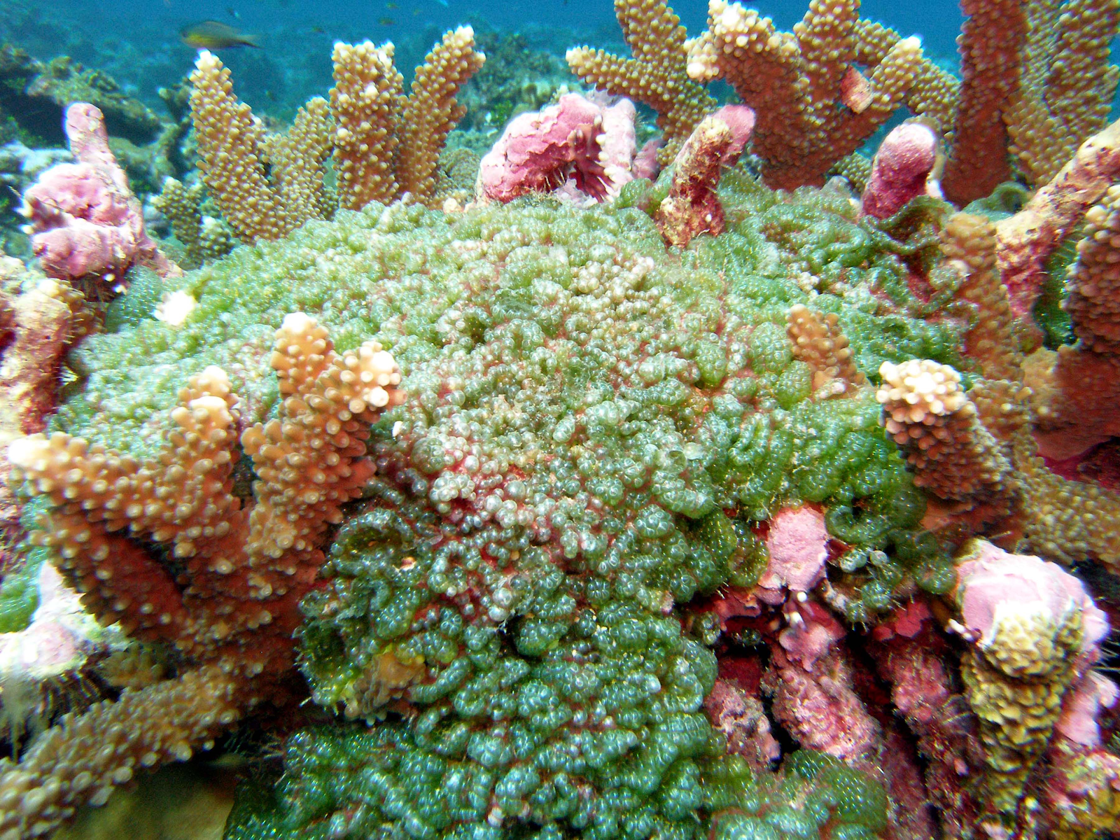
How Does Competition With Turf Algae Affect The Coral Microbiome?
Katie Visnius
Sterling Gordon-Fournier

